Slide 1
Outline:
Day 1: A biologically motivated python exercise (writing a simulator)
Day 2: Performing simulations at scale and comparing them to data (detecting positive selection)
Day 3: An introduction to machine learning and deep learning (machine learning exercise)
Day 4: Applications of machine learning to evolutionary genetics (detecting positive selection via deep learning)

Slide 2
Outline:
Day 1: A biologically motivated python exercise (writing a simulator)
Day 2: Performing simulations at scale and comparing them to data (detecting positive selection)
Day 3: An introduction to machine learning and deep learning (machine learning exercise)
Day 4: Applications of machine learning to evolutionary genetics (detecting positive selection via deep learning)

Slide 3
Machine Learning Application in Evolutionary Genetics
Dan Schrider

Slide 4
Today’s outline
Detecting sweeps with machine learning
Demographic inference
Recombination rate estimation
Detecting introgression
Misc other deep learning stuff!

Slide 5
Part 1
Detecting sweeps with machine learning
Demographic inference
Recombination rate estimation
Detecting introgression
Misc other deep learning stuff!

Slide 6

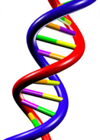
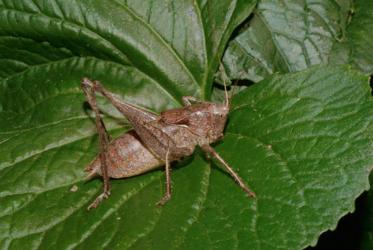
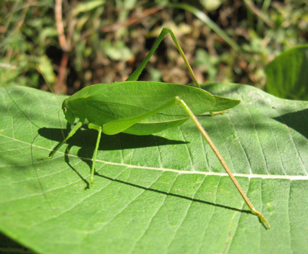
Positive selection
mutation + selection

Slide 7
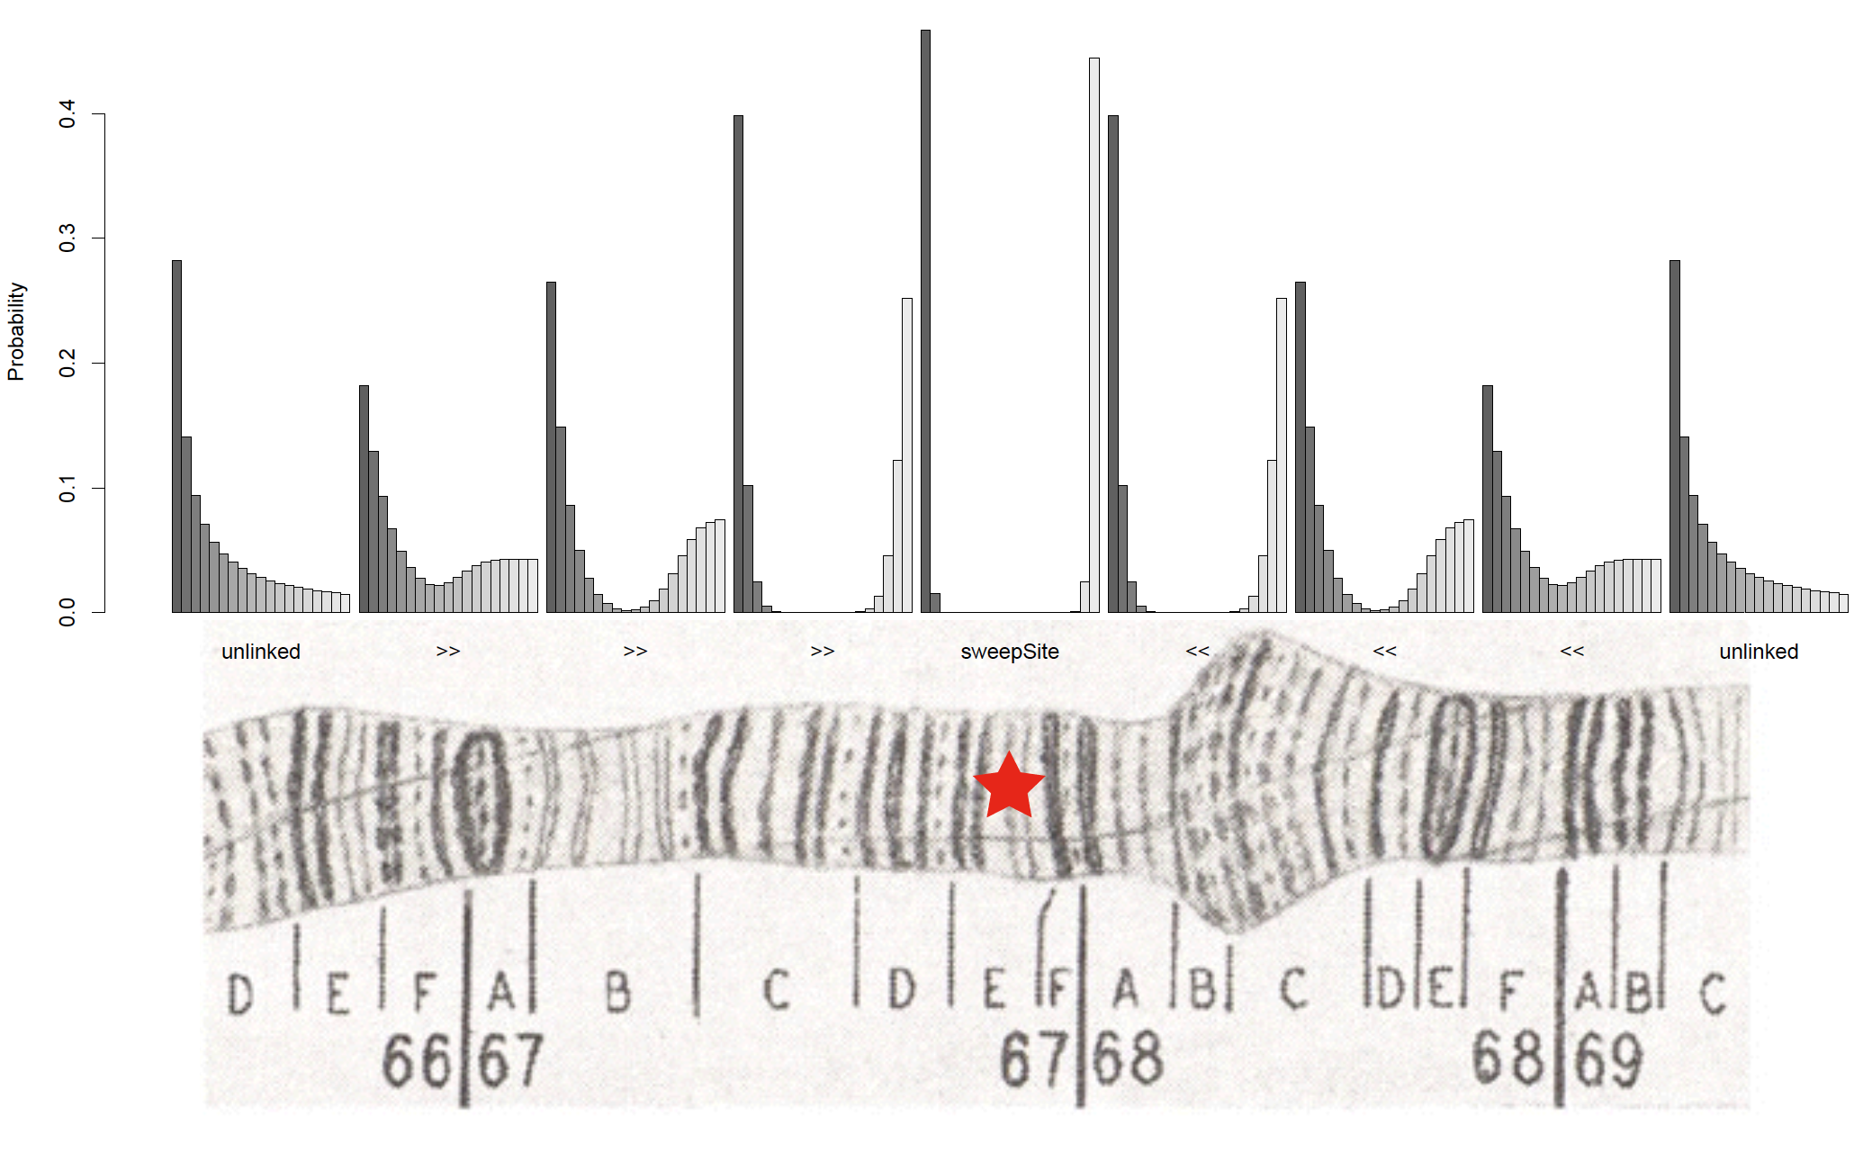
Sweeps and the spatial skew in allele frequencies
Nielsen et al. (2005)

Slide 8
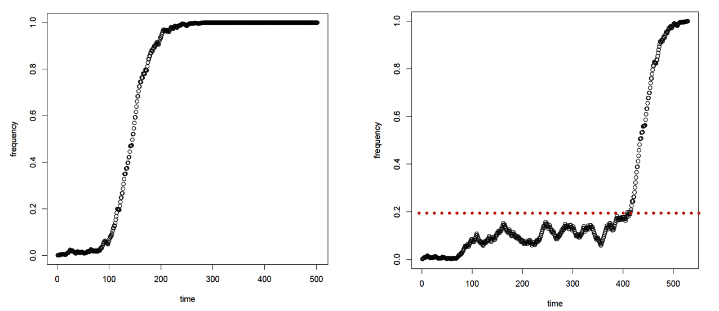
Two modes of adaptation:
Change in environment
Selection on de novo mutation
“Hard Sweep”
Selection on standing variation
“Soft Sweep”
These models produce quantitatively and qualitatively different effects on spatial patterns of variation.

Slide 9
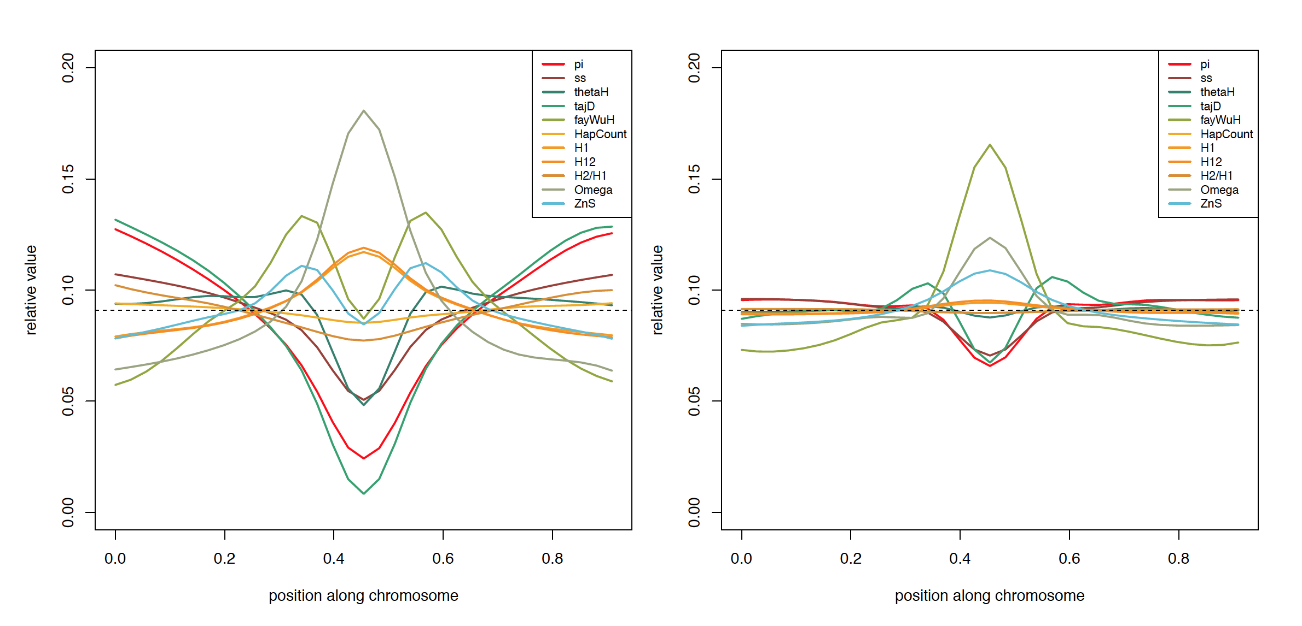
The spatial effect of a sweep is multi-dimensional
Hard Sweep
Soft Sweep
Idea: calculate each of these statistics in several windows around the focal site

Slide 10


When to use machine learning?
Good for cases where mechanistic models are hard to come by
Supervised learning: good when lots of training data can be obtained
Good for high-dimensional data!

Slide 11
Spatially aware methods
evolBoosting: Tajima’s D, Fay and Wu’s H, and their components, and iHH
S/HIC: π, Tajima’s D, Fay and Wu’s H, the number of distinct haplotypes, average haplotype homozygosity, average r², Kim and Nielsen’s ω, etc
Trendsetter: π, avg r², # of distinct haplotypes, and the H₁₂ family of statistics
Note: rather than calculating these in subwindows: Trendsetter uses trend-filtered regression.

Slide 12
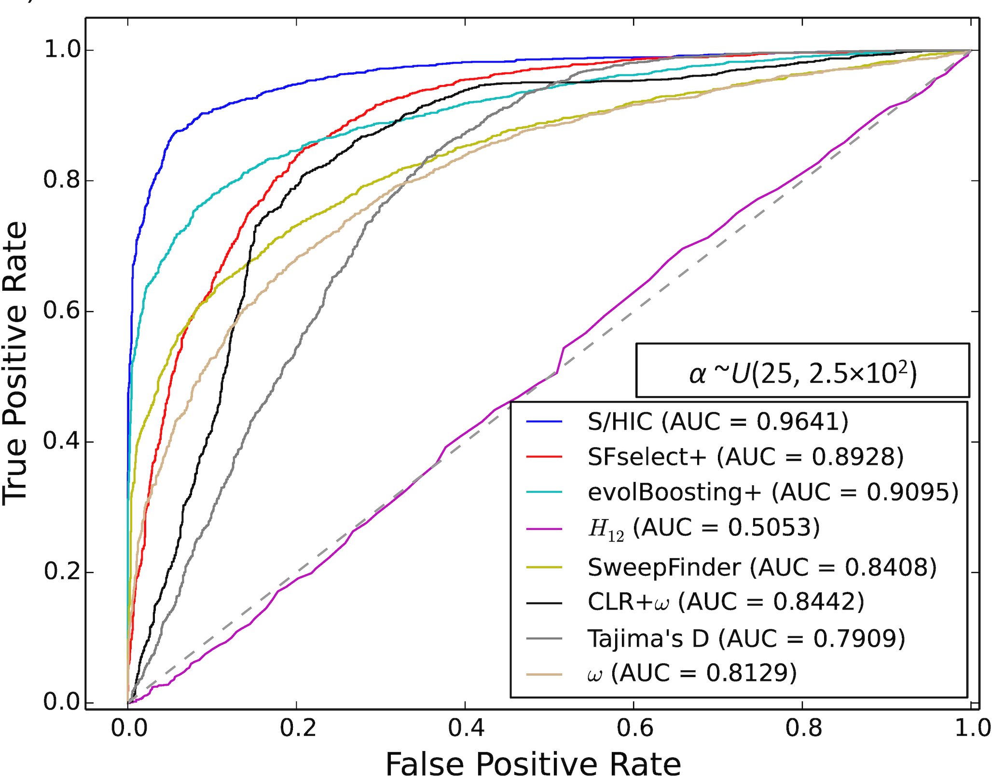
Power on simulated data
Note: the top methods on this data set are all machine learning approaches
(Trendsetter not shown, but does at least as well as S/HIC)

Slide 13
Traditional machine learning versus weird pop gen machine learning
Typical machine learning: train and test on real dataset before applying to some other real dataset
--perhaps some confidence that training/test data are distributed somewhat similarly to the application data set
Weird pop gen machine learning: train and test on simulated data before applying to real data
--perhaps you can hope that the training/test data are distributed somewhat similarly to the real data, if you are careful enough in designing your simulations…

Slide 14
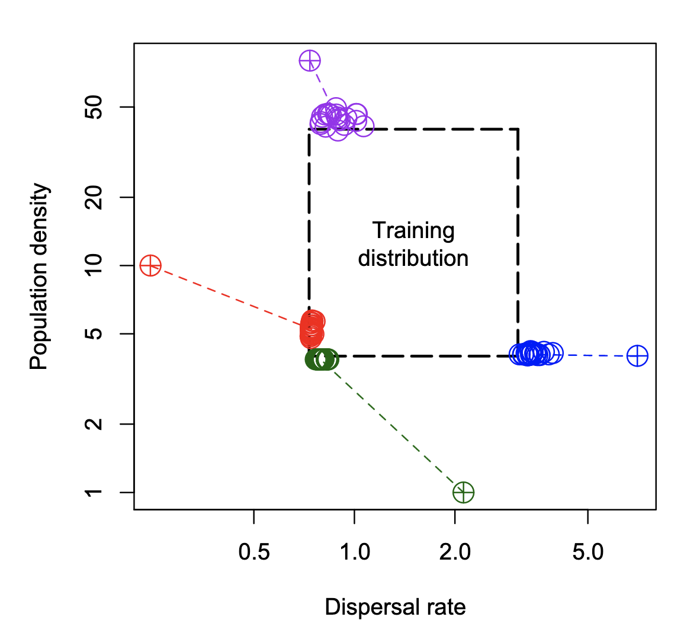
An illustration of the misspecification problem
Smith et al. (2024)

Slide 15
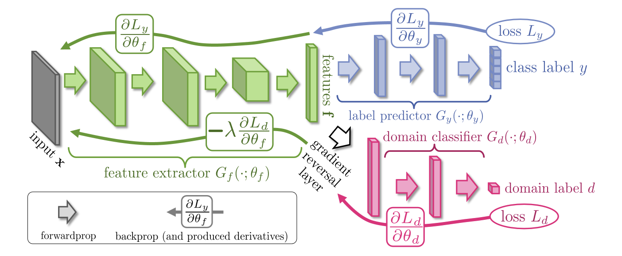
Bypassing the misspecification problem with domain adaptation
Ganin and Lempitsky (2014)

Slide 16
Summary (part 1 – sweeps)
Detecting sweeps is a difficult problem
By allowing us to capture more aspects of the input data, machine learning methods can help improve our power.
Some methods may suffer in the case of model misspecification: need to simulate lots of test data to find out! (Or use domain adaptation)

Slide 17
Part 2
Detecting sweeps with machine learning
Demographic inference
Recombination rate estimation
Detecting introgression
Misc other deep learning stuff!

Slide 18
Why do we care about inferring demographic histories?
Because it’s interesting.
We need an appropriate null model for detecting selection.

Slide 19
Population size change vs. sweeps
Smaller N
Large N

Slide 20
Evidence of selection?
Compared to what?

Slide 21
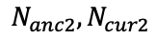
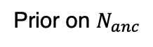
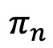
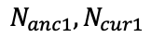

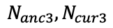
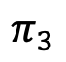

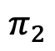
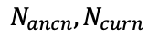
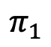
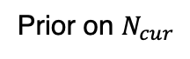
In pop gen, ABC predates ML in combining summary statistics
Prior on $N_{anc}$
Prior on $N_{cur}$
$$π$$
Summary statistic from real data set.
$$N_{anc1}, N_{cur1}$$
$$N_{ancn}, N_{curn}$$
$$N_{anc2}, N_{cur2}$$
$$N_{anc3}, N_{cur3}$$
Simulation 1
Simulation 2
Simulation 3
Simulation n
Which simulations “look like” our real data?
$$π_{1}$$
$$π_{2}$$
$$π_{3}$$
$$π_{n}$$
Estimate posterior probability distribution of model params from these “accepted simulations”
Posterior distribution of $N_{anc}$
Adapted from Sunnaker et al. 2013

Slide 22
Strengths and limitations of ABC
Benefits of ABC:
flexibility: if you can simulate it and summarize it, then you can do inference (in principle)!
produces posterior density
Weaknesses:
you typically need a LOT of simulations
for every prediction we have to examine the entire training set
What about machine learning?

Slide 23
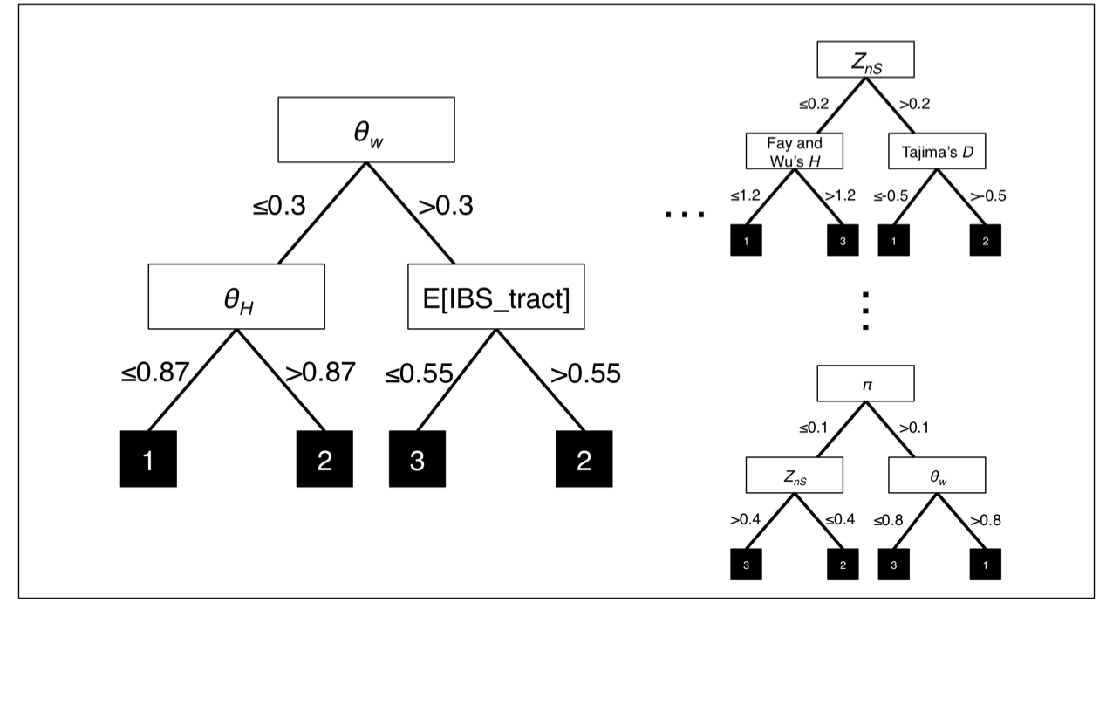
abcrf’s approach to demographic model selection
acbrf is just a Random Forest

Slide 24
abcrf beats ABC, and does it with fewer simulations
Method | Error with 10,000 training examples | Error with 20,000 training examples | Error with 50,000 training examples
ABC | 57.46% | 53.76% | 51.03%
abcrf | 40.18% | 38.94% | 37.63%
Pudlo et al. (2016)

Slide 25
Random Forest Regressor
Feature 2
Feature 1
≤0.78
>0.78
Feature 5
Feature 7
…
≤0.67
>0.67
≤0.4
>0.4
≤0.9
>0.9
16, 17
40, 50, 55
31, 57
3, 20, 27
Feature 2
Feature 3
…
≤0.87
>0.87
≤0.55
>0.55
Feature 2
≤0.1
>0.1
16, 17, 20, 27
3
31, 40
50, 55, 57
Feature 5
Feature 7
≤0.39
>0.39
≤0.85
>0.85
55, 57
50
3, 16, 17
20, 27, 31, 40

Slide 26
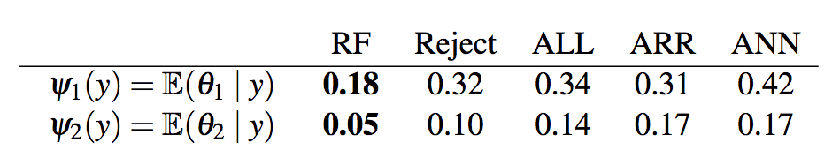
Parameter inference with abcrf
results on toy example, compared to various flavors of ABC:
Mean error for param 1:
Mean error for param 2:
Raynal et al. (2017)

Slide 27
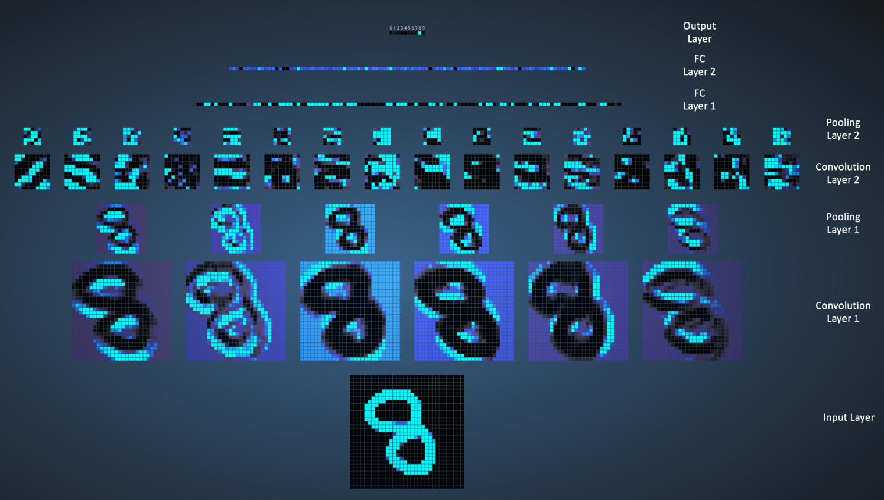
Convolutional Neural Network
image made by Ujjwal Karn using Adam Harley’s awesome interactive tool

Slide 28
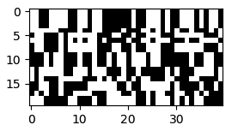
What if this is our input?
…
Samples
Genomic positions
What can we infer about a population sample’s evolutionary history using a CNN?

Slide 29
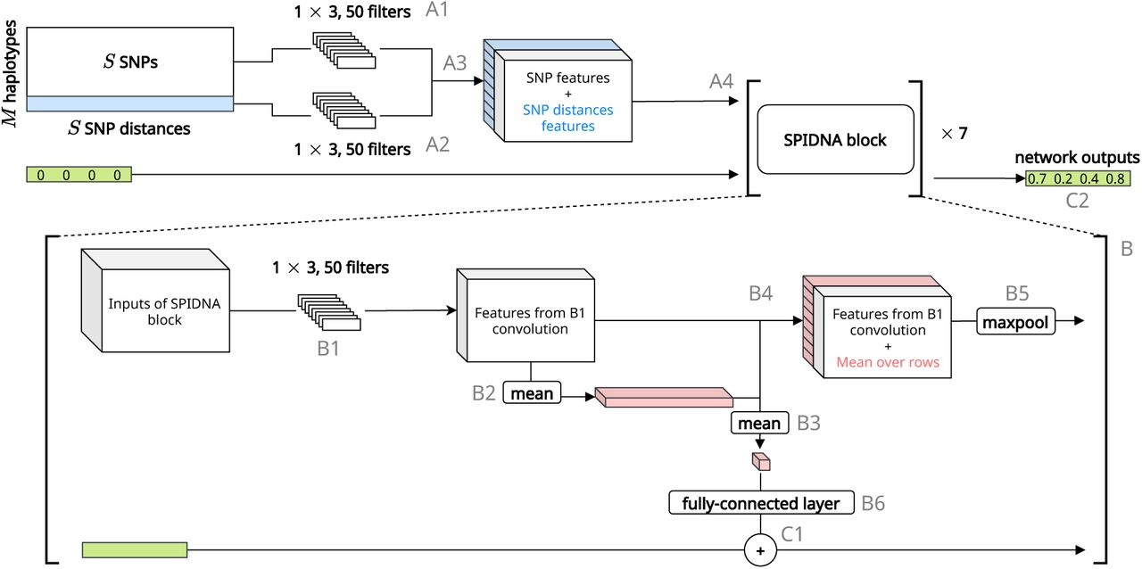
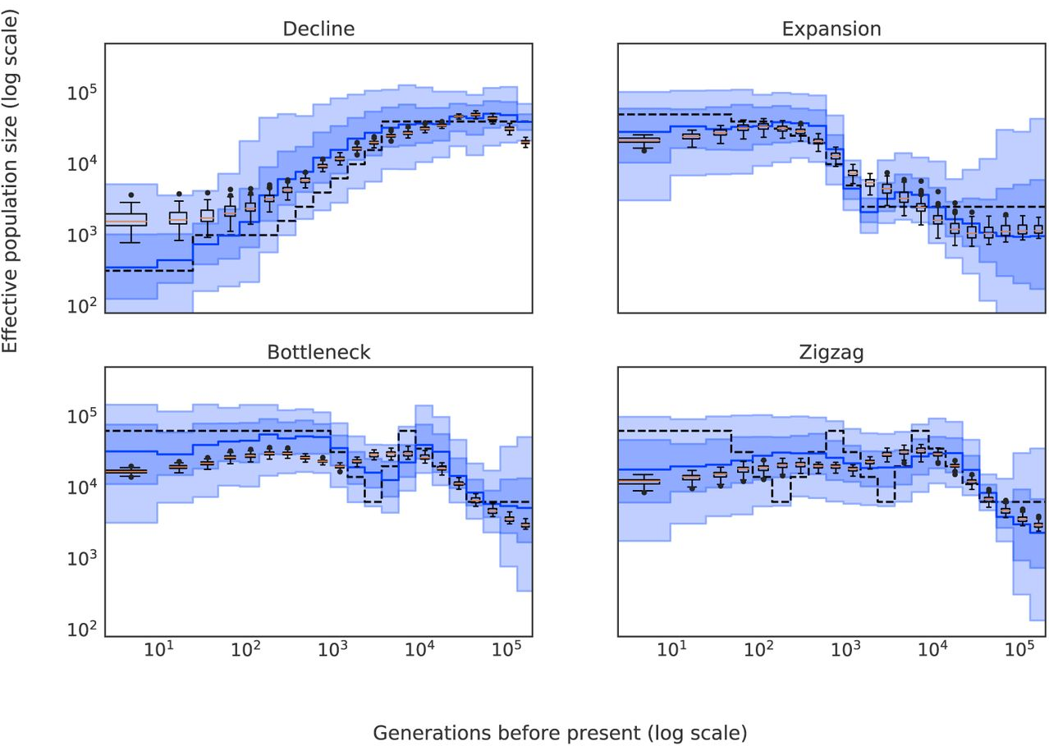
Inferring demographic parameters
Sanchez et al. 2020

Slide 30
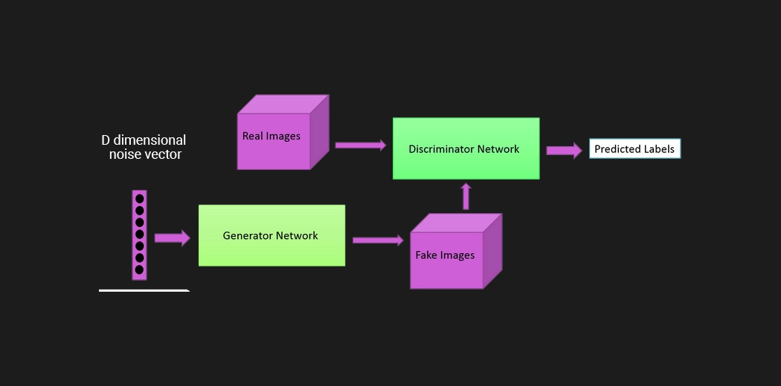
Generative adversarial networks

Slide 31
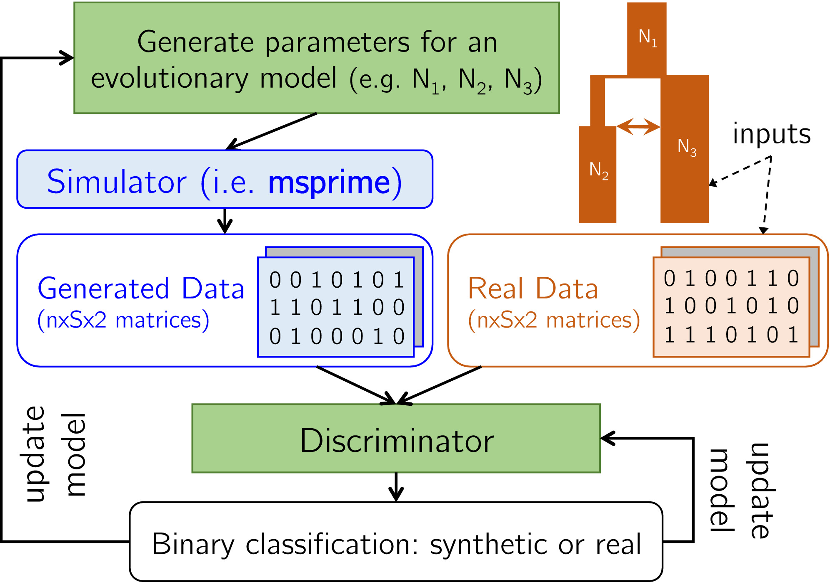
Inferring demographic parameters with pg-gan
Wang et al. (2021)

Slide 32
Summary – demographic inference
Machine learning approaches are well suited for demographic inference (natural alternative to ABC)
Creative new approaches are possible.

Slide 33
Part 3
Detecting sweeps with machine learning
Demographic inference
Recombination rate estimation
Detecting introgression
Misc other deep learning stuff!

Slide 34
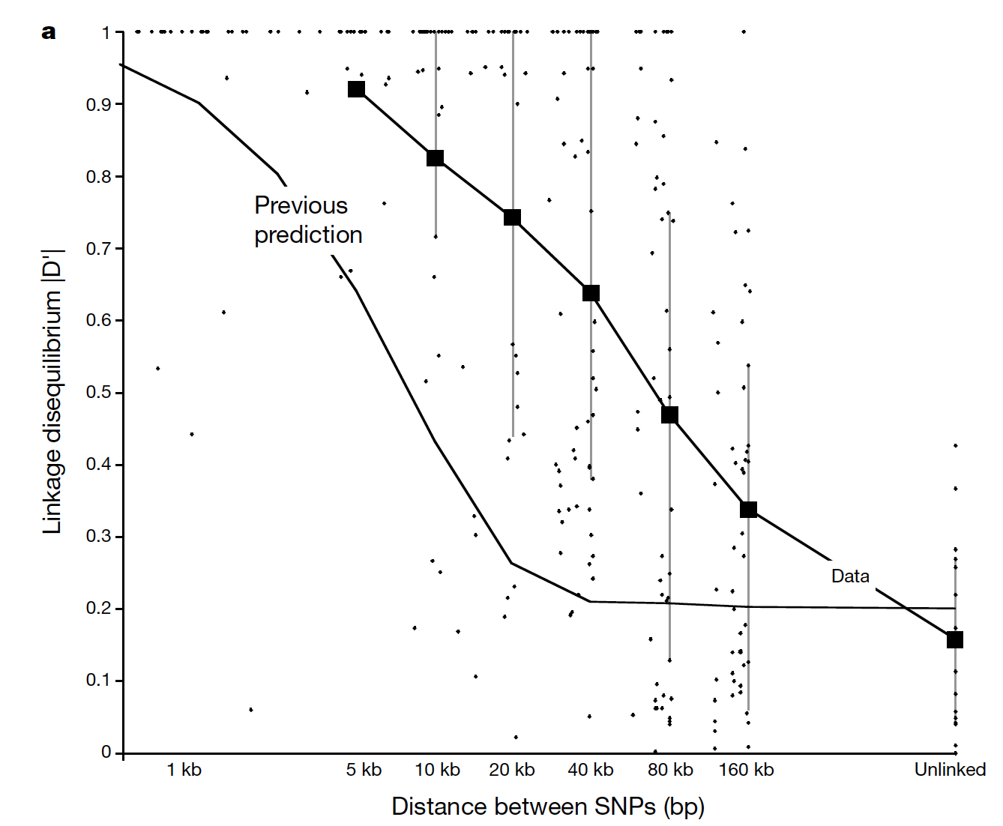
LD decays with distance
r
A
B
Δ_{r}x₁ = –rD
r increases with physical distance between two sites

Slide 35
FastEPRR: estimate ρ=4Nr via boosting
We wish to calculate ρ in a window of fixed size.
First, in each window calculate each of the following:
Mean value of S_{k}² (Hudson 1987)
Mean r² for all pairs of SNPs in the window
Mean haplotype homozygosity
The number of distinct haplotypes
Simulate a training set, and train a regressor via boosting
Lin et al. (2013), Gao et al. (2016)

Slide 36
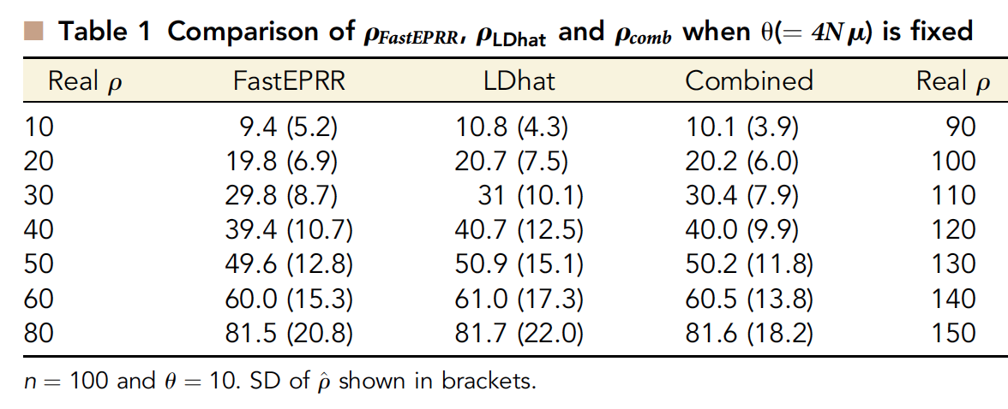
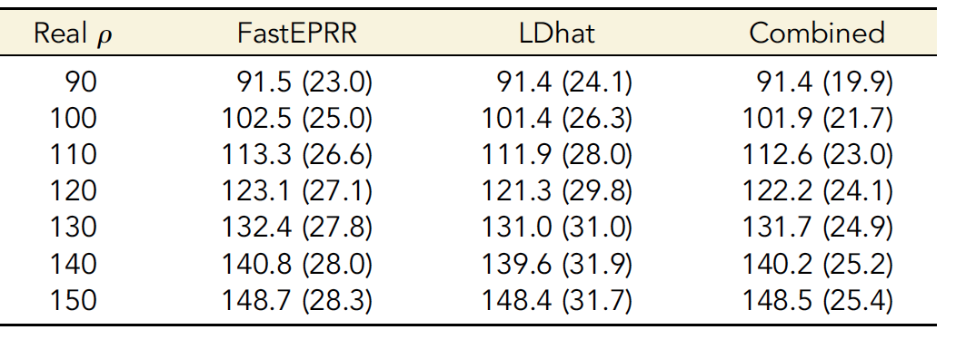
Similar accuracy to LDhat
Gao et al. (2016)

Slide 37
Advantages of FastEPPR
FastEPRR can naturally handle missing data
--Simply incorporate into your training simulations
FastEPRR can use much larger sample sizes:
--Full 1KG data set on single core:
~3d for FastEPR
years for LDhat
Larger sample size -> higher accuracy.

Slide 38
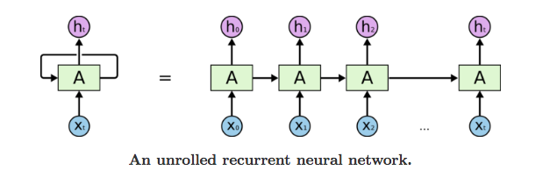
Why not use recurrent neural networks?
Recurrent neural network
The observation X_{t} at any given step can be the alignment column

Slide 39
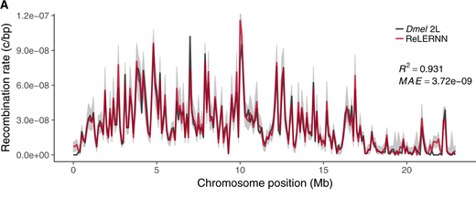
Estimating recombination rates with an RNN
Adrion et al. 2020

Slide 40
Summary (recomb rate)
FastEPRR is pretty impressive (accurate and fast)
Deep learning seems to be super-effective here!

Slide 41
Part 4
Detecting sweeps with machine learning
Demographic inference
Recombination rate estimation
Detecting introgression
Misc other deep learning stuff!

Slide 42



Detecting introgression
vs.

Slide 43
Single Statistic vs. Feature Vector
d_{min}
[π₁, π₂, θ_{w1}, θ_{w2}, Z_{nS1}, Z_{nS2}, F_{ST}, d_{min}, G_{min}, d_{d1}, d_{d2}, Z_{X}, IBS …]

Slide 44

Finding Introgressed Loci using Extra-Trees
Snn
d_{min}
≤0.78
>0.78
…
Taj D₂
>0.6
Taj D₂
≤0.1
>0.1
≤0.6
≤-0.9
>-0.9
2
3
3
1
d_{d1}
d_{d1}
…
≤2.0
>2.0
≤1.0
>1.0
G_{min}
≤0.05
>0.05
1
2
3
2
E[IBS]
>100
E[IBS]
≤100
≤50
≤50
2
3
3
1
Schrider et al. (2018; PLoS Genetics)

Slide 45
Single statistics have little power
d_{min}
G_{min}
P_{M}
P_{M}
T_{M}
T_{M}
False positive rate: 5%

Slide 46
FILET has exceptional power
FILET
d_{min}
P_{M}
G_{min}
T_{M}
FP rate: 5%
False positive rate: 0.09%

Slide 47
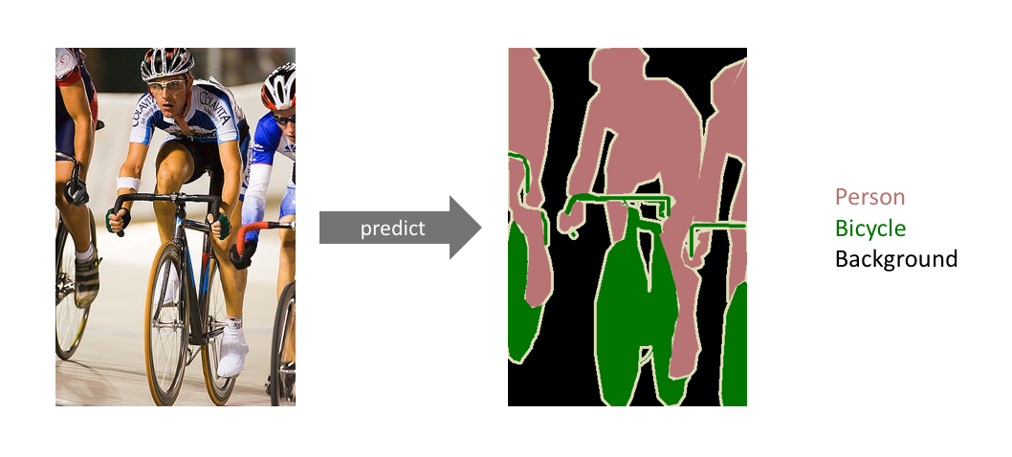
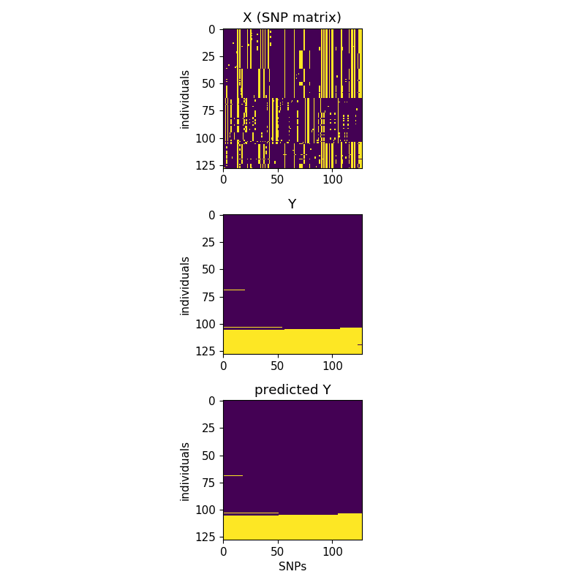
Localizing introgression via Semantic Segmentation
Input alignment
Introgressed haplotypes
Prediction
Population 1
Population 2
Segregating sites
Segregating sites
Segregating sites

Slide 48
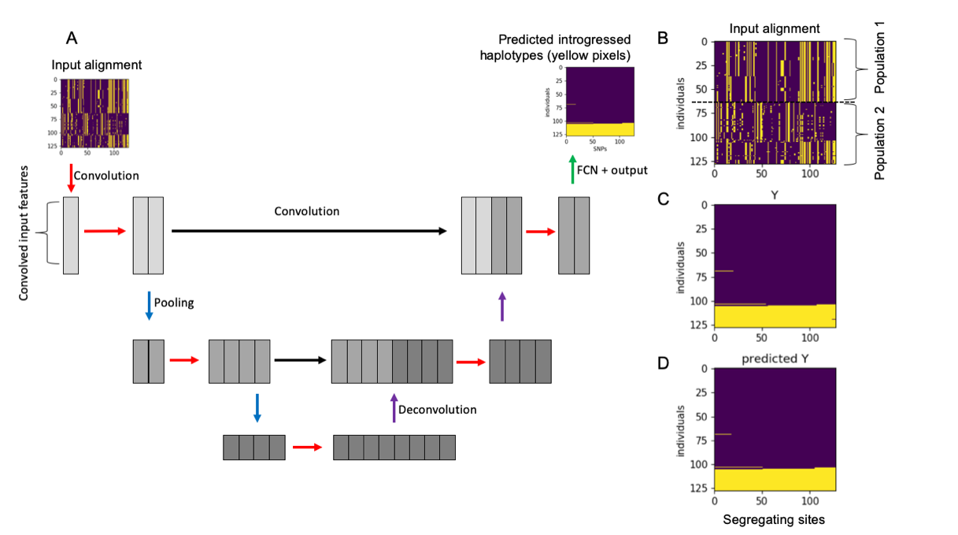

UNET for detecting introgression
Dylan Ray
Ray et al. (2024)

Slide 49
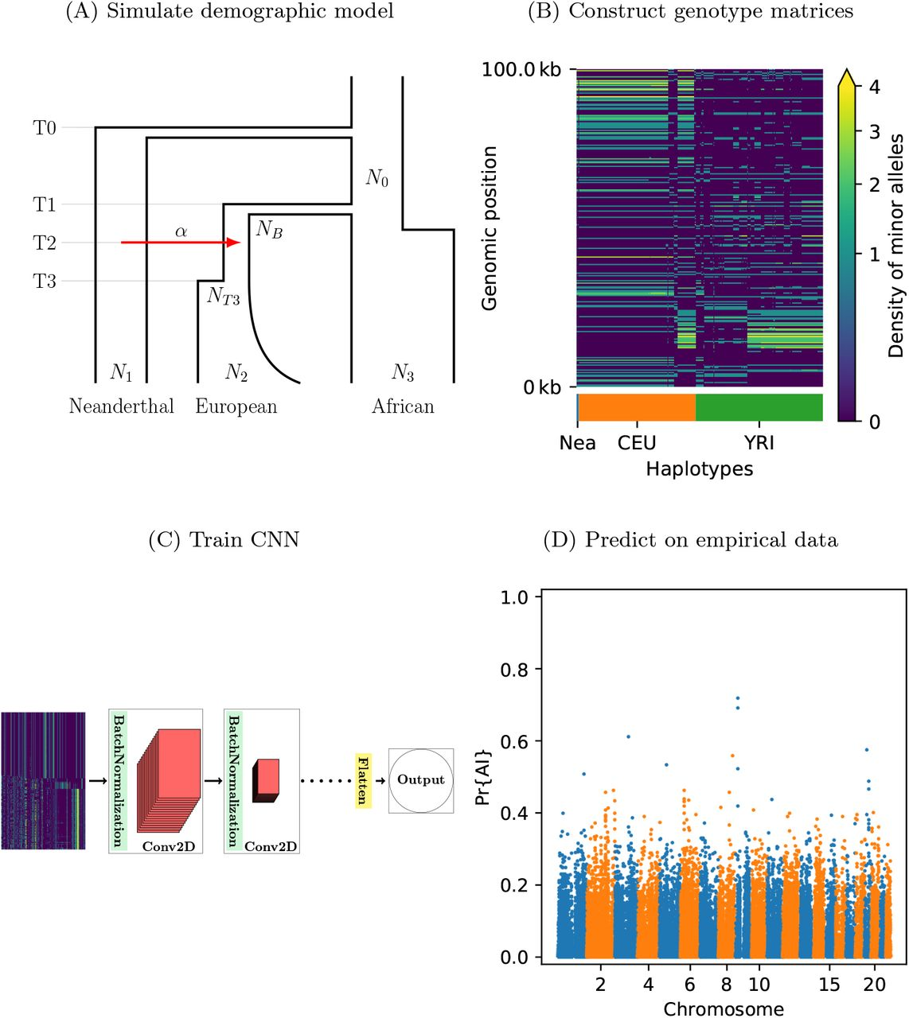
Adaptive introgression
Gower et al. 2020

Slide 50
Summary (introgression)
Yep, it works.

Slide 51
Part 5
Detecting sweeps with machine learning
Demographic inference
Recombination rate estimation
Detecting introgression
Misc other deep learning stuff!

Slide 52
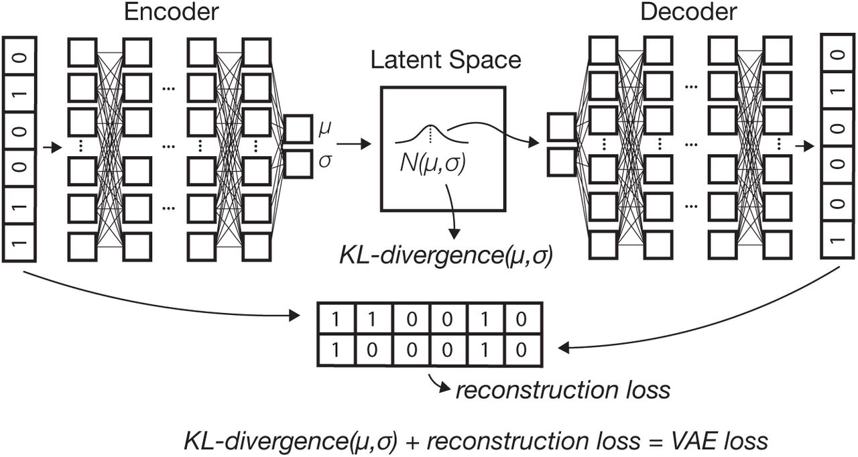
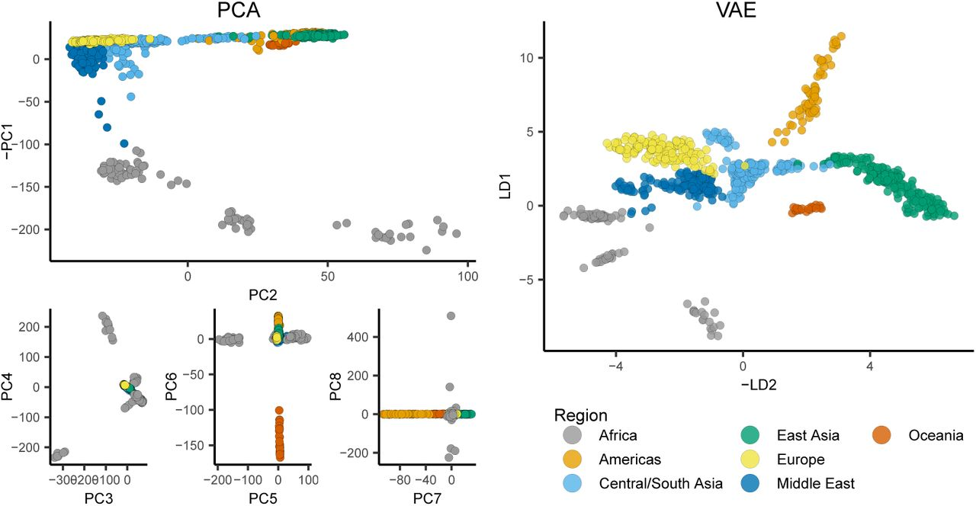
Visualizing population structure
Variational autoencoder – popvae
Battey et al. 2020a

Slide 53
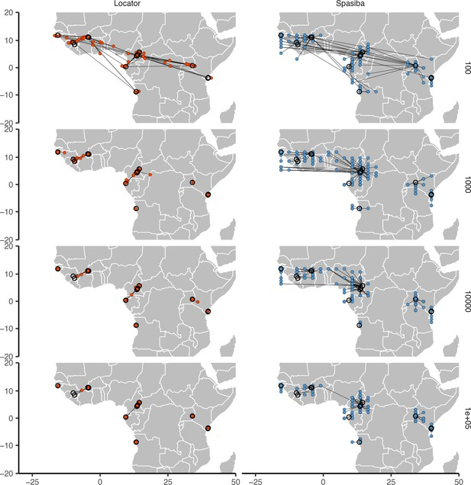
Predicting location from genotypes
Battey et al. 2020b

Slide 54
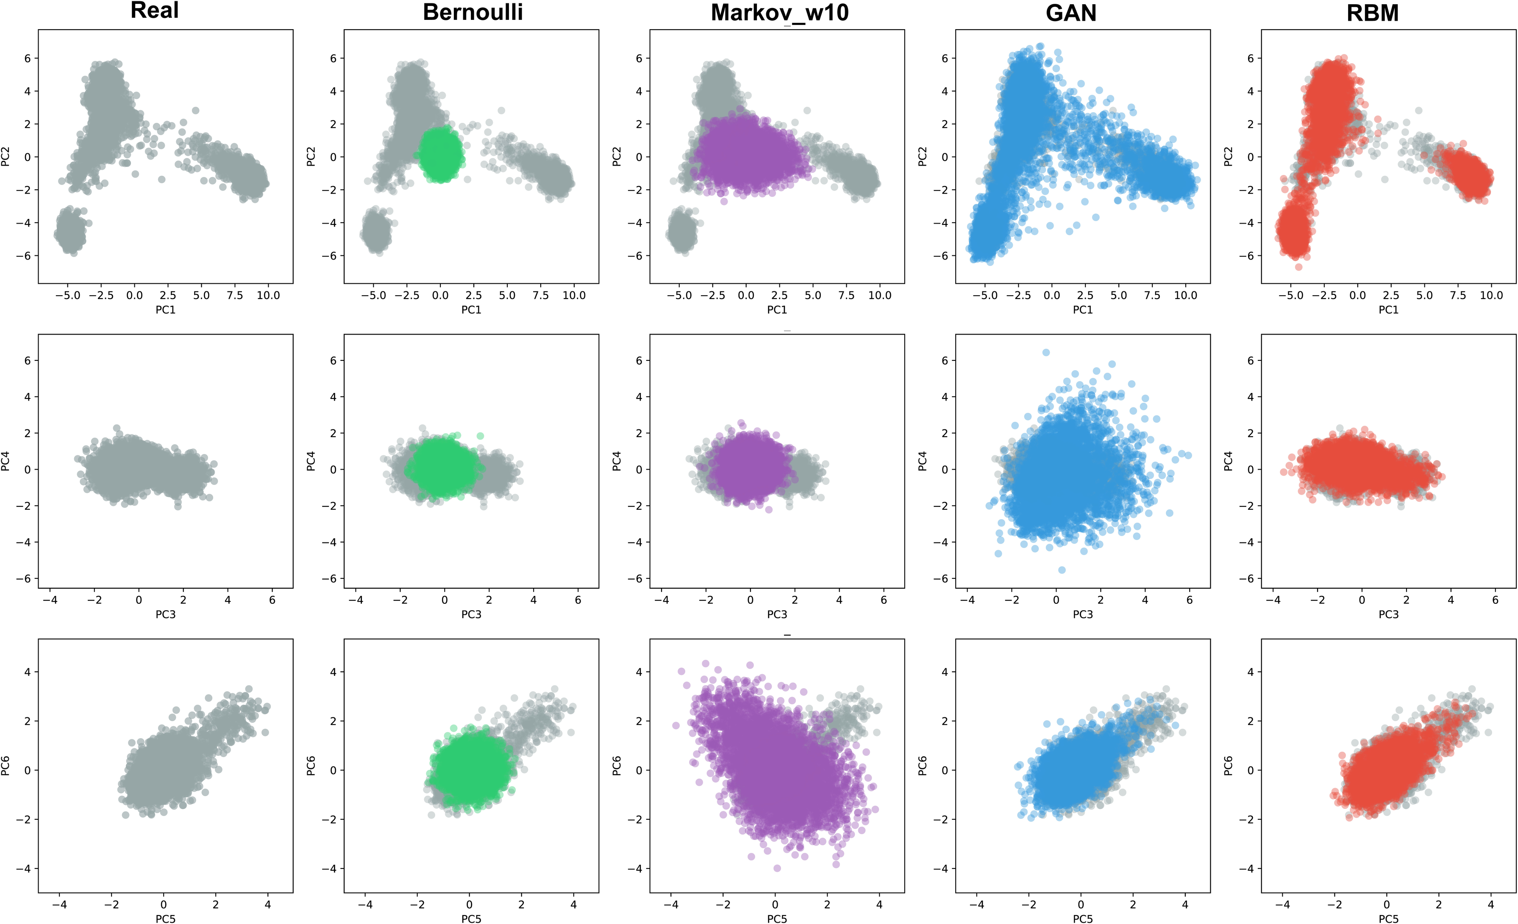
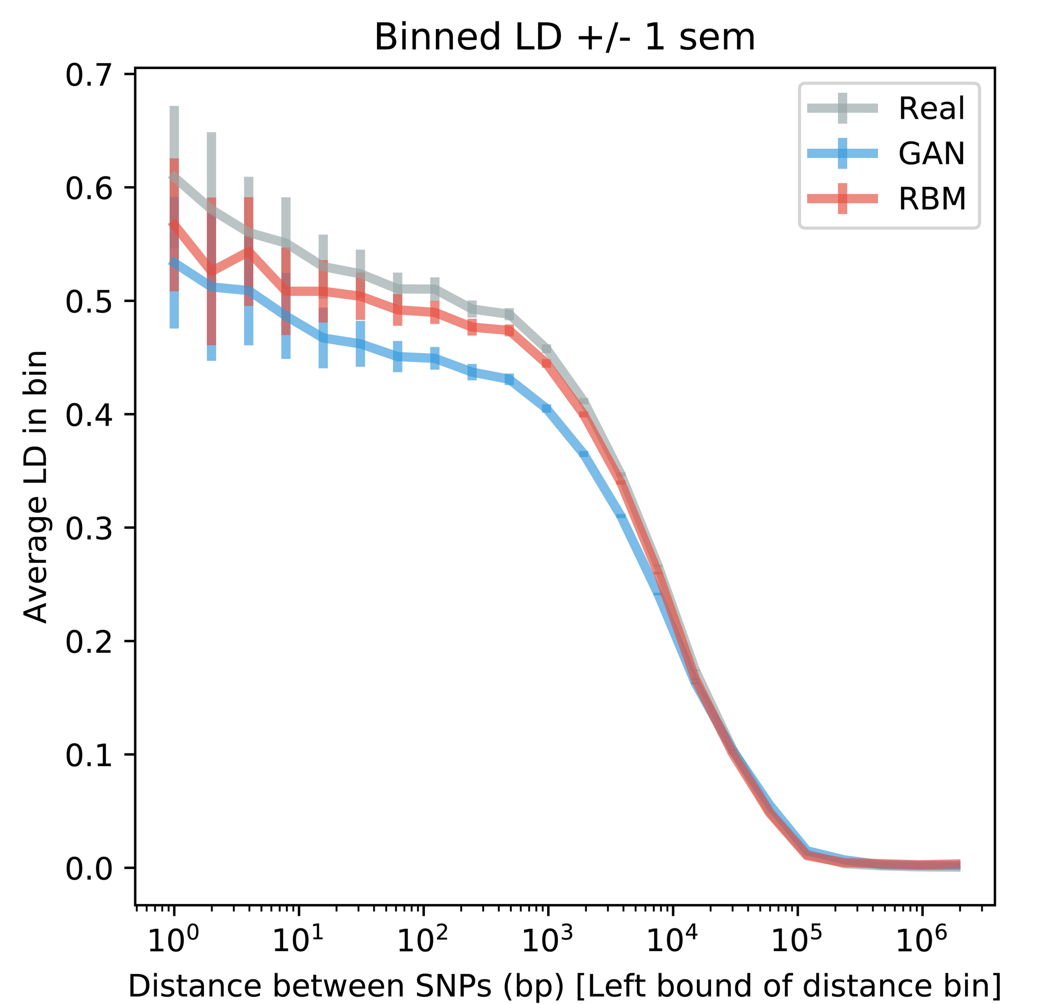
Generating artificial genomes
Yelman et al. 2020

Slide 55
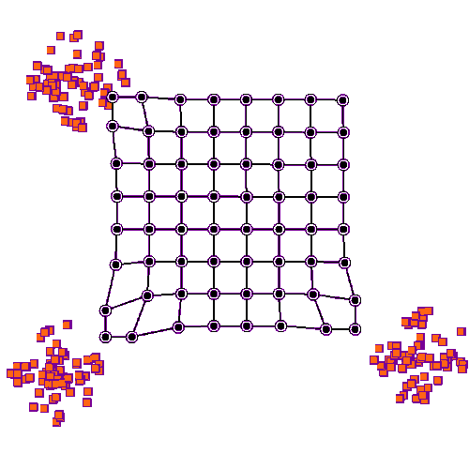
Species delimitation via self-organizing maps (SOMs)
Pyron (2024)

Slide 56
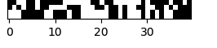
Inferring phylogenetic trees with a CNN
vs.
vs.
A
B
C
A
C
B
C
B
A
Suvorov et al. (2020, Sys Bio)

Slide 57
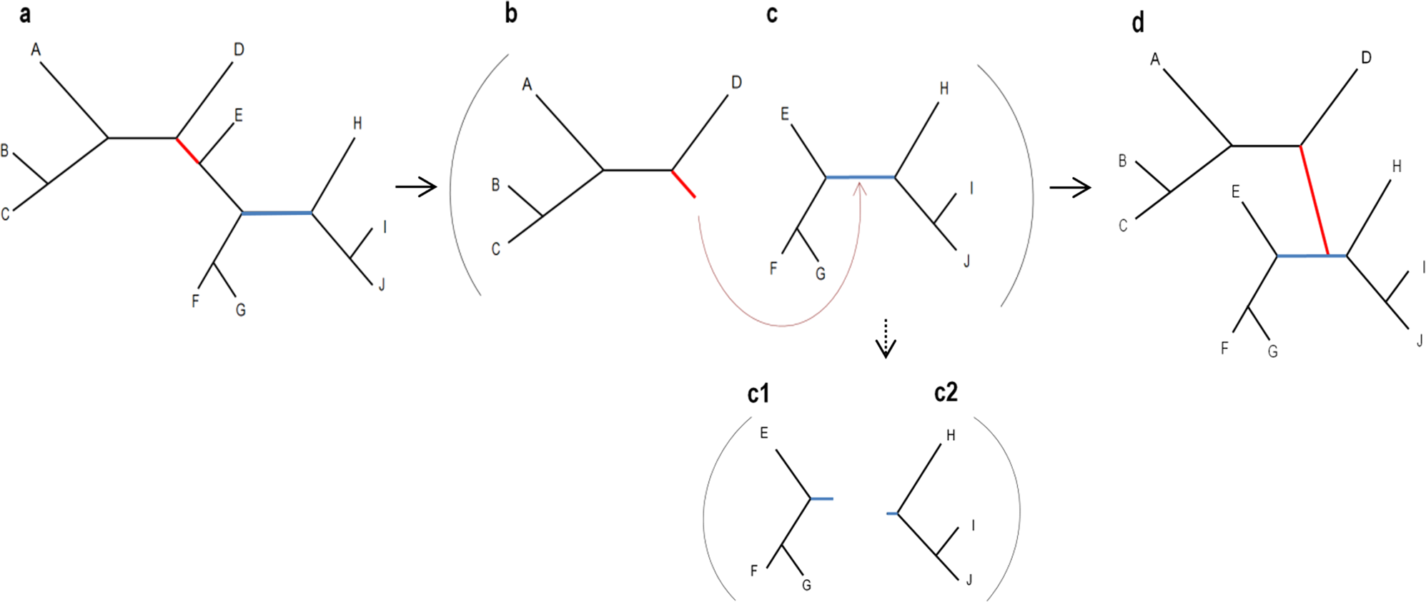
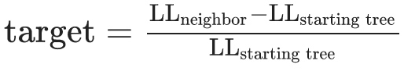
Accelerating the search through phylogenetic tree-space
Azouri et al. (2021)

Slide 58
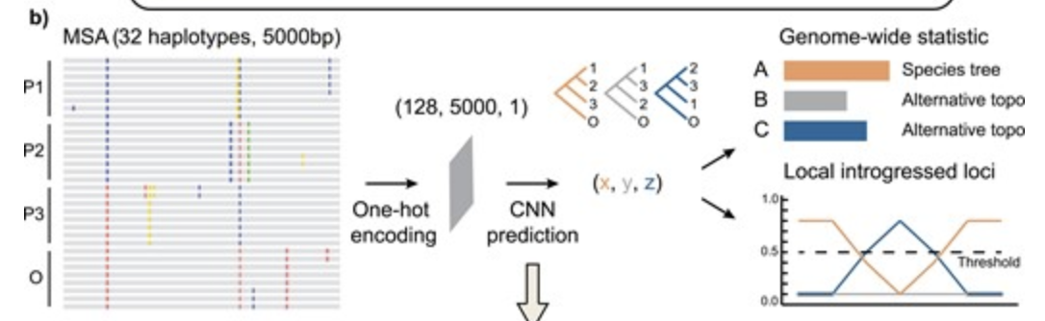
Detecting ancient introgression from phylogenetic data
ERICA (Evolutionary Relationship Inference using a CNN-based Approach)
Zhang et al. (2023)

Slide 59
Conclusions
1) Artificial neural networks can be trained to make inferences about a wide variety of evolutionary phenomena.
2) Deep neural networks can let us skip the step of calculating summary statistics.
3) Extremely flexible: can be applied to any problem for which we can obtain training data (no stats required).
4) Practical challenges remain. (Optimal representation, optimal network architecture, handling large/many alignments, etc). But things are moving FAST.

